Slide 1
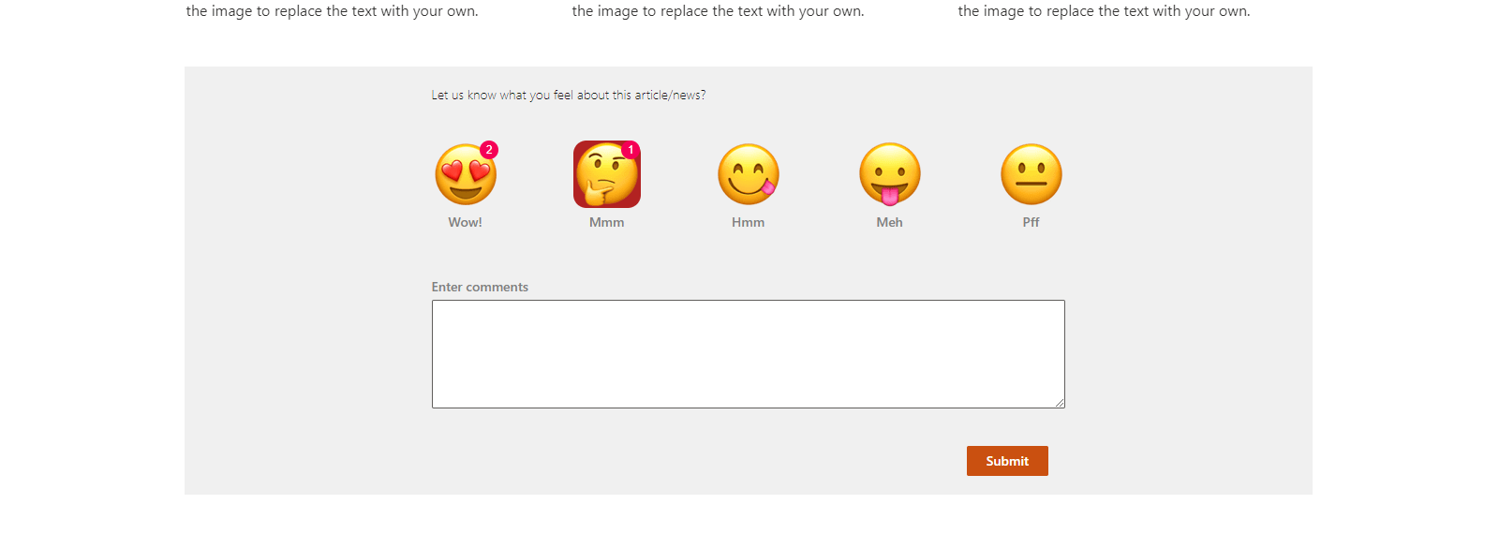

SPFx webpart for emoji based reaction or feedback
react-emoji-ratings
Siddharth Vaghasia (@siddh_me)

Slide 2








Siddharth Vaghasia
https://siddharthvaghasia.com
https://c-sharpcorner.com/members/siddharth-vaghasia
@siddh_me
siddharth-vaghasia
https://www.linkedin.com/in/siddharthvaghasia

Slide 3

react-emoji-ratings
SPFx webpart to take emoji based reaction or feedback for particular news/article/posts
https://github.com/pnp/sp-dev-fx-webparts/tree/main/samples/react-emoji-ratings

Slide 4
Driving factor
Feedback is important be it positive or negative….
I have seen emoji-based feedback on public News or articles
What if we can build something for internal Organization's news
Take employee/user's feedback as emoji reactions on news.
This webpart can also be used on wiki articles or blog posts to take similar reactions

Slide 5
Summary
Configurable header text, rating text, and images
We can choose to show from minimum one rating to max 5 rating images and text
Option to show total count of particular rating count as badge
Option to show and capture comments from user when submitting feedback
Display current user's rating selection with highlighted background
Allow user to change rating(update rating)
Stores ratings in SharePoint List
Option to create list on the fly and choose list to store the ratings
Option for admin to choose background color

Slide 6
Demo/ Code Walkthrough

Slide 7
THANK YOU

